Slide 1


Slide 2
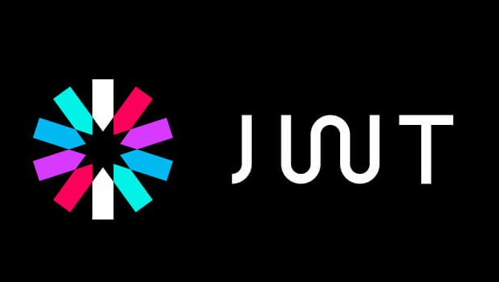
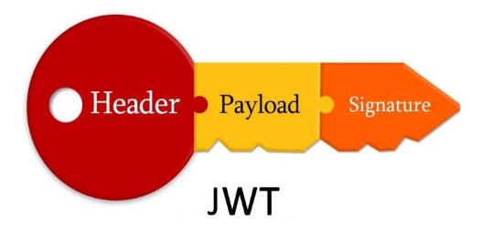

1. What is jwt token
2. What is Jwt token hacking
3. Impact of JWt token hacking
4. Live Demo

Slide 3
What is jwt token
Json Web Tokens (JWTs) are commonly used in many applications to validate the client’s identity.
The JWT token is provided during authentication in case of success and this is then used in all authenticated interactions to the web application.
The validation of user’s identity is based on the user’s information stored in the JWT token which is signed by the server using JSON Web Signatures.

Slide 4

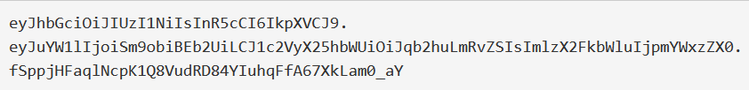
The JWT format
A JSON Web Token consists of a header, payload, and signature in base64url encoding, separated by dots
HEADER.PAYLOAD.SIGNATURE

Slide 5
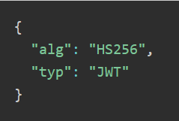
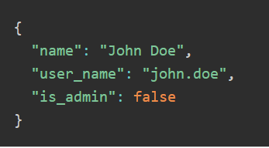
The header contains metadata about the token, such as the algorithm used for the signature and the type of the token (which is simply JWT). For this example, the header before encoding is:
The payload contains information (claims) about the entity (user) that is going to be verified by the application. Our sample token includes the following claims:

Slide 6
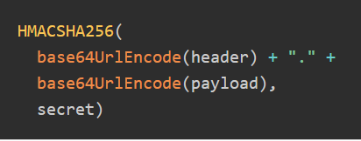
Depending on the algorithm in the header; encrypt the header, dot & payload with 'base64url' encoding.
Then everything should be encrypted with symmetric (HS256) or asymmetric (private key) signatures
This gives us the following signature, which is then appended (after a dot) to the base64url-encoded header and payload:

Slide 7
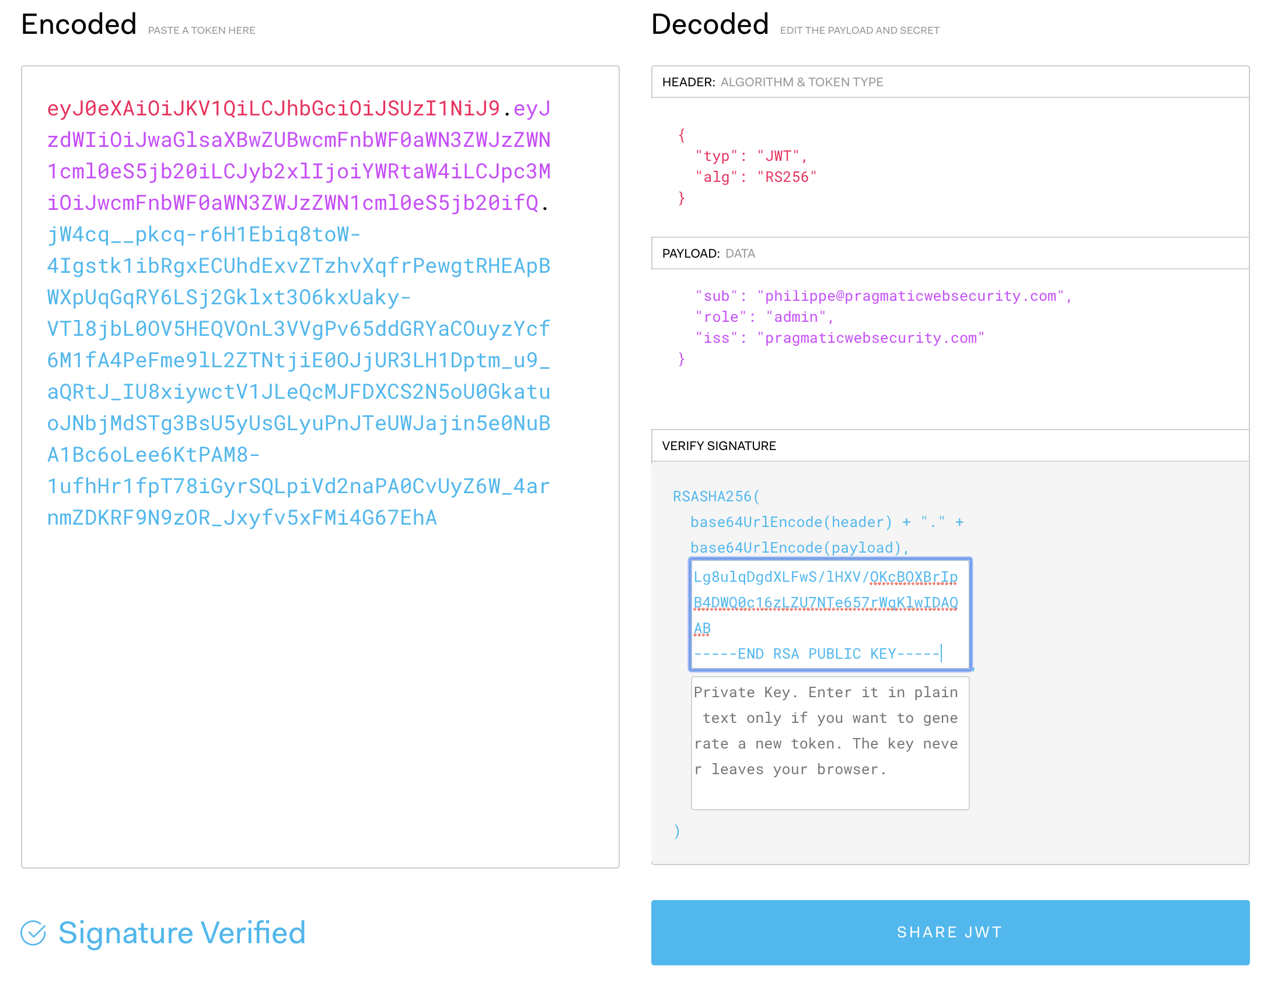

Slide 8
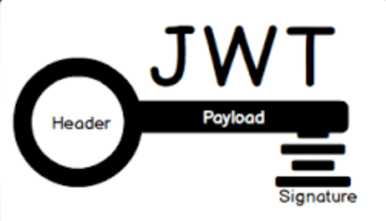
What is Jwt token hacking
1. Information leakage
Since JSON web tokens are used for access control, they often contain information about the user.
If the token is not encrypted, anyone can base64 decode the token and read the token’s payload. So if the token contains sensitive information, it might become a source of information leaks.
A properly implemented signature section of the JSON web token provides data integrity, not confidentiality.

Slide 9
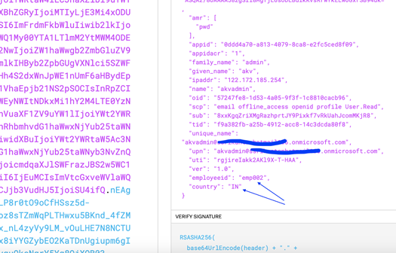

Slide 10
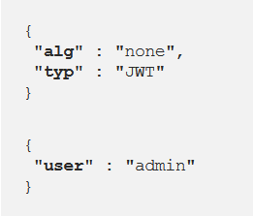
2.None Algorithm Attack
JWT supports a “none” algorithm. If the alg field is set to “none”, any token would be considered valid if their signature section is set to empty.

Slide 11
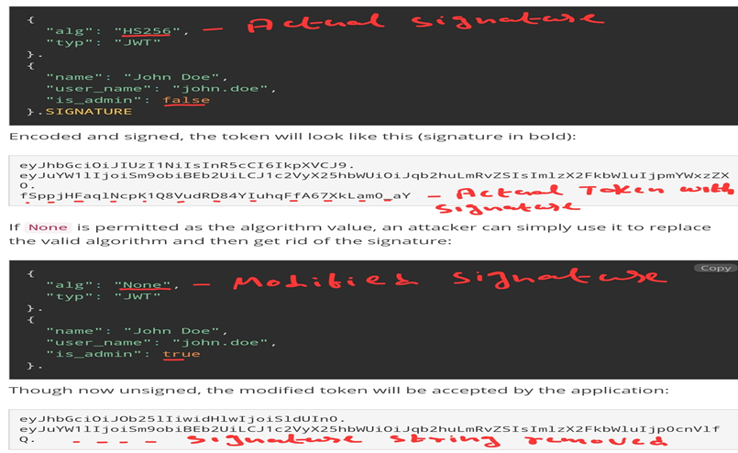
Checking by Encoding again by modifying the algorithm to None from HS256 and pass it on.

Slide 12
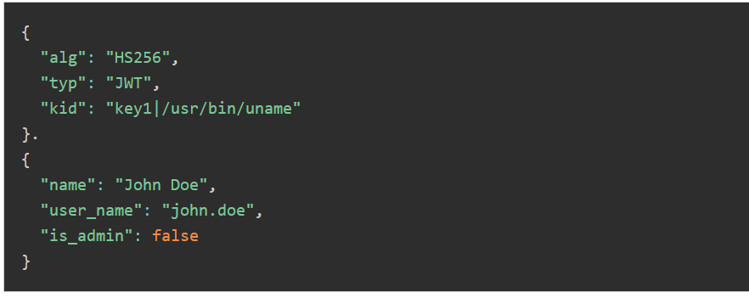
3.Kid Parameter attack
KID is parameter seen in jwt token, And if the parameter is not properly validated it leads to attacks like Command injection, LFI, SQLi etc.
Since the KID is often used to retrieve a key file from the file system, if it is not sanitized before use, it can lead to a directory traversal attack.

Slide 13
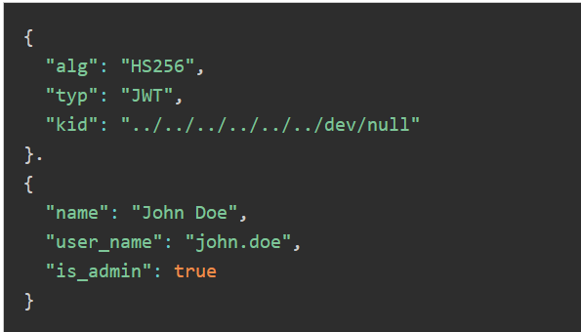
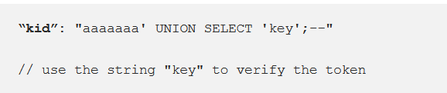

Slide 14
4. Changing the algorithm from “RS256” to “HS256”
The HMAC algorithm uses a single key for doing both the tasks.
Hence, this method changes the workflow from Asymmetric encryption to Symmetric encryption and allows using the same public key for signing new tokens.

Slide 15
Impact of JWt token hacking
Sensitive Information Disclosure
The authenticity of client can be compromised
It leads Account takeover
Attackers can access the Server Files
they might be able to read data from the underlying SQL database
JWt token hacking Resources
https://medium.com/swlh/hacking-json-web-tokens-jwts-9122efe91e4a
https://blog.convisoappsec.com/en/json-web-tokens-tips-and-procedures-for-secure-implementation/

Slide 16
THANK YOU

